Slide 1
OCULOMOTOR SYSTEM

Slide 2
1st order neuron – retina to pretectal nucleus
nasal fibres – contralateral pretectal nucleus
temporal fibres – ipsilateral pretectal nucleus
2nd order neuron – connects each pretectal nucleus to both edinger westphal nuclei,therefore unilateral light stimulus – bilateral symmetrical pupillary constriction
damaged by syphilis – light – near dissociation
3rd order neuron – E.W. nucleus to ciliary ganglion
Aneurysm – 3rd nerve palsy + pupil involvement
In orbit – parasympathetic fibres – inferior division of 3rd nerve – via nerve to I.O. – ciliary ganglion
4th order neuron – leaves ciliary ganglion , passes with short ciliary nerves- innervate the sphincter pupillae

Slide 3
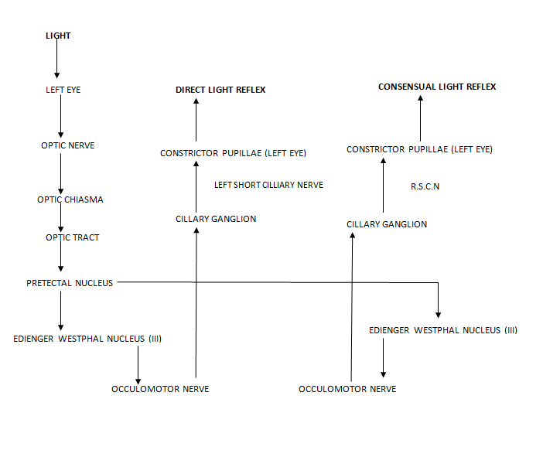

Slide 4
7 types of 3rd cn palsies
nuclear IIIrd nerve palsies
fascicular syndromes of the IIIrd nerve
uncal herneation syndrome of IIIrd nerve
posterior communicating artery aneurysm
cavernous sinus syndrome of IIIrd nerve
orbital syndrome of the IIIrd nerve
pupil-sparing, isolated IIIrd nerve palsies

Slide 5
1) nuclear IIIrd nerve palsies
- very rare specific prerequisites for diagnosis based on IIIrd n. subnuclear arrangements
ORIGIN:3rd nerve complex in periaqueductal gray matter just anterior to the aqueduct of sylvius at level of superior colliculus
The MLF abuts the the nucleus laterally and ventrally
LATERAL SUBNUCLEUS-ipsilateral IO+IR+MR(inferior division)
MEDIAL SUBNUCLEUS-contralateral SR(major clue in identifying nuclear palsy)
CENTRAL CAUDAL SUBNUCLEUS-b/l LPS
EW SUBNUCLEUS-parasympathetic innervation b/l
superior division

Slide 6
2) fascicular syndromes of the IIIrd nerve
- IIIrd nerve + superior cerebellar peduncle = Nothnagel’s syndrome
- IIIrd nerve + red nucleus = Benedikt’s syndrome
- IIIrd nerve + cerebral peduncle = Weber’s syndrome
- IIIrd nerve + superior cerebellar peduncle + red nucleus = Claude’s syndrome

Slide 7
3) uncal herneation syndrome of IIIrd nerve
- IIIrd passes along free edge of tentorium cerebelli
- with expanding supratentorial mass lesions, the uncal portion of the undersurface of the temporal lobe may compress the IIIrd nerve
Pupil is usually involved early and predominantly-HUTCHINSON PUPIL
Generally ipsilateral 3rd cn palsy but sometimes contralateral(false localizing)
A false localizing hemiparesis is much more common than a false localising 3 rd cn palsy

Slide 8
5) cavernous sinus syndrome of IIIrd nerve
- involvement of III +/- IV +/- VI nerves +/- oculosympathetics
- may give rise to primary misdirection syndromes of the IIIrd nerve
Aberrant Regeneration of the IIIrd Nerve = misdirection syndrome = acquired oculomotor synkinesis
Bielschowsky’s Hard-Wiring theory: - after a IIIrd palsy, anomalous branching develops during regeneration so that structures originally supplied are anomalously re-innervated on the basis of miswiring = secondary misdirection syndromes
primary misdirection syndromes = where no previous IIIrd nerve palsy was present
eyelid-gaze dyskinesis –pseudo grafes sign-upper lid may retract on down gaze due to IR fibres aberrantly innervating LPS
pupil-gaze dyskinesis –pseudo argyll robertson pupil –pupillary light reaction is poor but constriction occurs on ocular adduction with early convergence or horizontal gaze

Slide 9
4) posterior communicating artery aneurysm-most common cause of painful, non-traumatic, IIIrd nerve palsy
3rd cn passes between posterior cerebral
artery and superior cerebellar artery
parallel to posterior communicating artery
PUPIL RULE-complete isolated 3rd cn palsy with pupil sparing is never due to aneurysm

Slide 10
6) orbital syndrome of the IIIrd nerve
- at orbital apex, IIIrd nerve splits into superior division (levator + SR muscle) and the inferior division (MR, IR, IO & parasympathetics)
- divisional IIIrd nerve palsies arise which are of localizing value to this locale
Pseudodivisional palsy-incomplete lesions involving fascicles in midbrain

Slide 11
Pupillomotor fibres pass superficially in superomedian part of nerve – supplied by pial blood vessels – while main trunk of 3rd nerve is supplied by vasa nervosum
Therefore aneurysm presses on pial vessels externally – total 3rd nerve palsy including pupils
Microangiopathy affects vasa nervosa- produces pupil sparing 3rd nerve palsy
7) pupil-sparing, isolated IIIrd nerve palsies
- small caliber, poorly myelinated parasympathetic fibers tend to locate to the superonasal portion of the peripheral IIIrd nerve
- 80% of diabetic IIIrd nerve palsies are pupil sparing
- 95% of compressive IIIrd nerve palsies have pupil involvement
Microvascular palsies are sudden onset painful,usually pupillary sparing,begin to resolve by about 2 months and donot result in aberrant regeneration

Slide 12
very short fascicular course so fascicular syndromes are rare
- IVth nerve usually affected at point of decussation [ = anterior medullary velum]
or along subarachnoid course
clinically:
- a IVth nerve palsy is the most common, isolated oculomotor nerve palsy seen
- in almost all of the neurological literature, a VIth nerve palsy is always quoted as #1
- the major problem in diagnosis is
in only 30% of recent onset IVth n. palsies is the diplopia maximal down-and-in where it customarily assessed
- vertical diplopia after closed head trauma is a IVth n. palsy until proven otherwise

Slide 13
FASCICULUS
Passes through red nucleus and then through medial aspect of cerebral peduncle
Lesion of the fasciculus leads to:
BENEDIKT’S SYNDROME – damage to dorsal part of fasciculus as it passes through red nucleus leads to ipsilateral 3rd nerve palsy , contralateral ataxia ,flapping tremors.
WEBERS SYNDROME- damage to the ventral part of fasciculus as it passes through cerebral peduncle leads to ipsilateral 3rd nerve palsy, contralateral hemiplegia.

